Slide 1
Classification Part 02
Naive Bayesian & Bayesian Network
.

Slide 2
Chapter 6. Classification and Prediction
Apa itu klasifikasi ? Apa itu prediksi
Beberapa hal terkait dengan klassifikasi and prediksi
Klasifikasi Bayesian
Data Mining: Concepts and Techniques

Slide 3
Supervised vs. Unsupervised Learning
Supervised learning (classification)
  Supervision (terawasi): Data training (observations, measurements, etc.) ada kelas dalam data training
  Data baru diklasifikasikan didasarkan pada data training
  Unsupervised learning (clustering)
  Label kelas data training tidak diketahui
  Measurements, pengamatan dengan tujuan pembentukan adanya kelas atau kelompok dalam data
Data Mining: Concepts and Techniques

Slide 4
Classification vs. Prediction
Classification
  Memprediksi label class (diskrit atau kontinu)
  mengklasifikasi data (membangun model) didasarkan pada data training dan nilai label class dalam mengklasifikasikan atribut dan digunakannya pada saat mengklasifikasikan data baru
Prediksi
  Memodelkan fungsi bernilai kontinu;yaitu memprediksi nilai yang tidak diketahui
Bentuk aplikasinya
  Persetujuan pinjaman atau kredit:
  Diagnosa medis: apakah hepatitis A atau B
  Deteksi kegagalan:
Data Mining: Concepts and Techniques

Slide 5



Process (1): Model Construction
Classification
Algorithms
Training
Data
Classifier
(Model)
IF rank = ‘professor’
OR years > 6
THEN tenured = ‘yes’
Data Mining: Concepts and Techniques

Slide 6




Process (2): Using the Model in Prediction
Classifier
Testing
Data
Unseen Data
(Jeff, Professor, 4)
Tenured?
Data Mining: Concepts and Techniques

Slide 7
Issues: Data Preparation
Data cleaning
  Memproses awal data untuk mengurangi noise dan mengatasi nilai-nilai yang hilang
Analisa relevansi (seleksi fitur)
  Menghilangkan atribut-atribut yang tidak relevan atau atribut yang redundan
Transformasi data
  Membangun normalisasi data
Data Mining: Concepts and Techniques

Slide 8
Issues: Evaluating Classification Methods
Akurasi
  Keakuratan klasifikasi : memperkirakan label class
  Keakurasisan prediksi: nilai yang ditebak dari atribut yang diprediksi
Kecepatan
  Waktu untuk membangun model (training time)
  Waktu dalam menggunakan model (classification/prediction time)
Kehandalan: mengatasi noise dan missing values
Data Mining: Concepts and Techniques

Slide 9
Bayesian Classification: Why?
A statistical classifier: membangun probabilistic prediction, yaitu memprediksi probabilitas keanggotaan kelas
Didasarkan pada Bayes’ Theorem.
Performance: sederhana ---- naïve Bayesian classifier,
Data Mining: Concepts and Techniques

Slide 10
Bayesian Theorem: Basics
X adalah data sample (“evidence”): label kelas tidak diketahui
H adalah dugaan (hypothesis ) bahwa X adalah anggota C
Klasifikasi ditentukan P(H|X), (posteriori probability), probabilitas bahwa dugaan terhadap data sample X
P(H) (prior probability), initial probability
  Misal X akan membeli computer, tidak memperhatikan age, income, …
P(X): probabilitas dari sample data yang diamatii
P(X|H) (likelyhood), probabilitas dari sample X, dengan the memperhatikan dugaan
  Misal , X akan membeli computer, probabilitas bahwa X. Adalah 31..40, penghasilan sedang
Data Mining: Concepts and Techniques

Slide 11
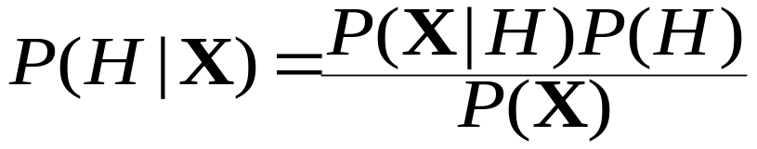
Bayesian Theorem
Dari training data X, posteriori probabilitas dari hypothesis H atau class, P(H|X), teorema Bayes
Ini dapat ditulis dengan
  posterior = likelihood x prior/evidence
Prediksi X anggota C₂ jika dan hanya jika probabilitas P(C₂|X) paling tinggi diantara semua P(C_{k}|X) dari semua kelas k
Data Mining: Concepts and Techniques

Slide 12
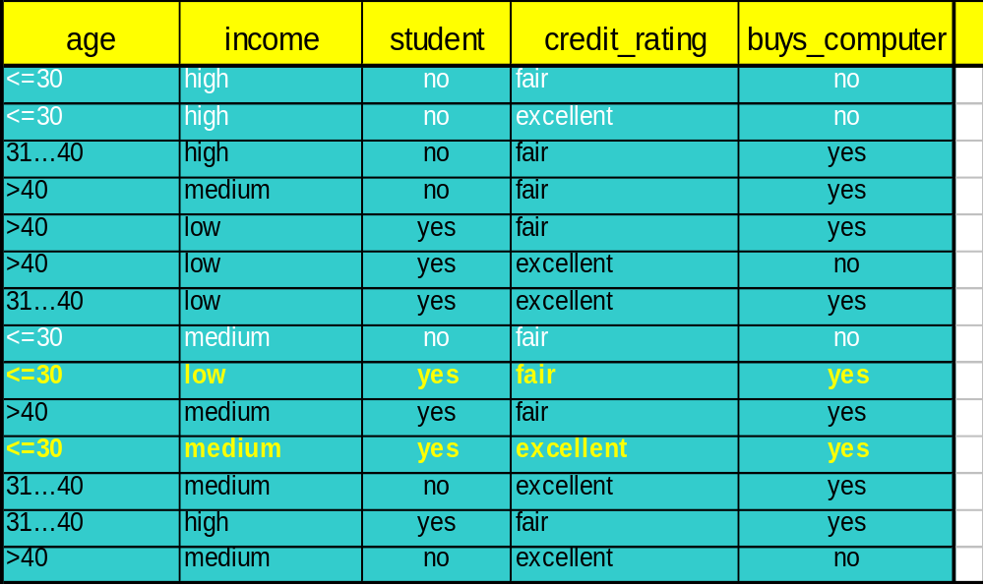
Naïve Bayesian Classifier: Training Dataset
Data Mining: Concepts and Techniques

Slide 13


Klasifikasi Naïve Bayesian
Perhatikan D adalah record training dan ditetapkan label-label kelasnya dan masing-masing record dinyatakan n atribut ( n field ) X = (x₁, x₂, …, x_{n})
Misalkan terdapat m kelas C₁, C₂, …, C_{m}.
Klassifikasi adalah diperoleh maximum posteriori yaitu maximum P(C_{i}|X)
Ini dapat diperoleh dari teorema Bayes
Karena P(X) adalah konstan untuk semua kelas, hanya
  Perlu dimaksimumkan
Data Mining: Concepts and Techniques

Slide 14
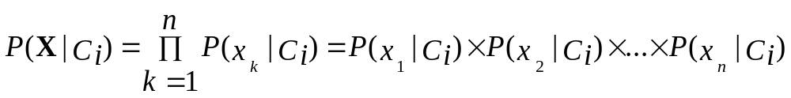
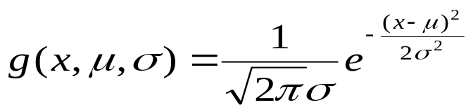

Derivation of Naïve Bayes Classifier
Diasumsikan: atribut dalam kondisi saling bebas (independent) yaitu tidak ada kebergantungan antara atribut-atribut :
A_{k} adalah categorical, P(x_{k}|C_{i}) adalah jumlah record dalam kelas C_{i} yang memiliki nilai x_{k} sama dengan A_{k} dibagi dengan |C_{i, D}| jumlah record dalam C_{i} dalam D
Jika A_{k} bernilai kontinu , P(x_{k}|C_{i}) biasanya dihitung berdasarkan pada distribusi Gausian dengan mean μ and standar deviasi σ
  Dan P(x_{k}|C_{i}) adalah
Data Mining: Concepts and Techniques

Slide 15
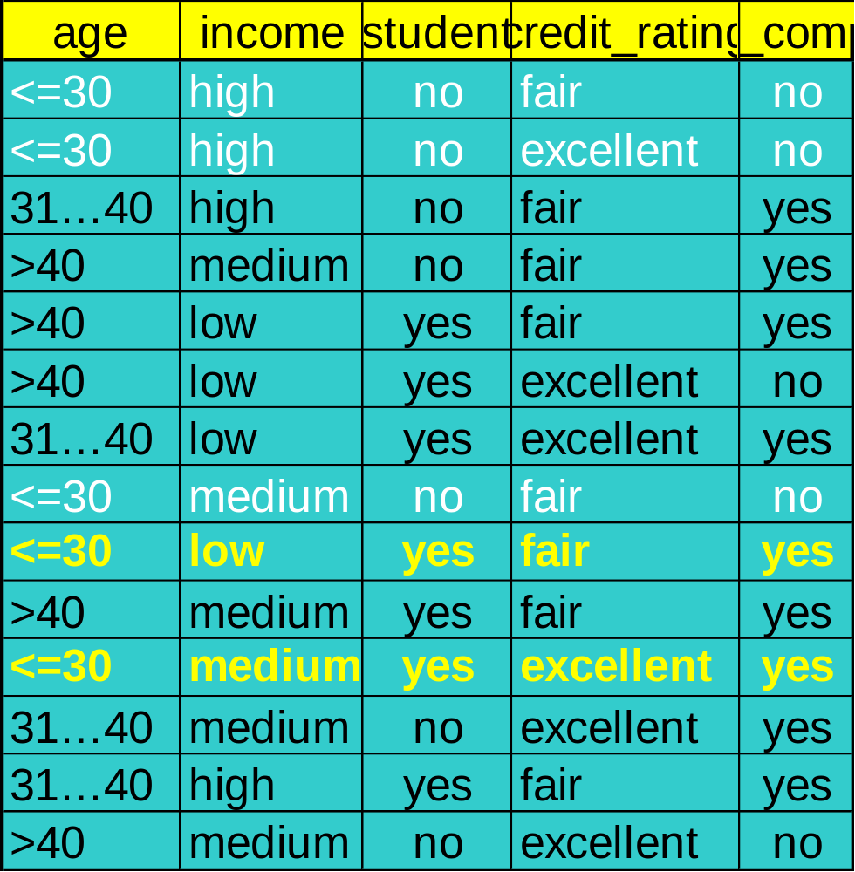
Naïve Bayesian Classifier: Training Dataset
Class:
C1:buys_computer = ‘yes’
C2:buys_computer = ‘no’
Data sample
X = (age <=30,
Income = medium,
Student = yes
Credit_rating = Fair)
D= 14
Data Mining: Concepts and Techniques

Slide 16
Naïve Bayesian Classifier: An Example
P(C_{i}): P(buys_computer = “yes”) = 9/14 = 0.643
P(buys_computer = “no”) = 5/14= 0.357
Compute P(X|C_{i}) for each class
P(age = “<=30” | buys_computer = “yes”) = 2/9 = 0.222
P(age = “<= 30” | buys_computer = “no”) = 3/5 = 0.6
P(income = “medium” | buys_computer = “yes”) = 4/9 = 0.444
P(income = “medium” | buys_computer = “no”) = 2/5 = 0.4
P(student = “yes” | buys_computer = “yes) = 6/9 = 0.667
P(student = “yes” | buys_computer = “no”) = 1/5 = 0.2
P(credit_rating = “fair” | buys_computer = “yes”) = 6/9 = 0.667
P(credit_rating = “fair” | buys_computer = “no”) = 2/5 = 0.4
X = (age <= 30 , income = medium, student = yes, credit_rating = fair)
P(X|C_{i}) : P(X|buys_computer = “yes”) = 0.222 x 0.444 x 0.667 x 0.667 = 0.044
P(X|buys_computer = “no”) = 0.6 x 0.4 x 0.2 x 0.4 = 0.019
P(X|C_{i})*P(C_{i}) : P(X|buys_computer = “yes”) * P(buys_computer = “yes”)
=0,044*0.643 = 0.028
P(X|buys_computer = “no”) * P(buys_computer = “no”) = 0.007
Sehingga , X belongs to class (“buys_computer = yes”)
Data Mining: Concepts and Techniques

Slide 17
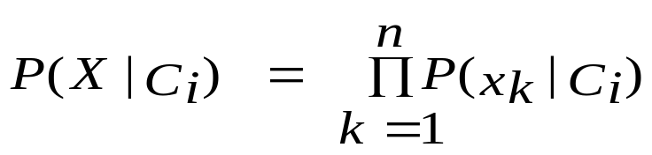
Menghindari masalah Probabilitas 0
Prediksi Naïve Bayesian membutuhkan masing-masing probabilitas tidak nol , Dengan kata lain. Probabilitas yang dihitung tidak menjadi nol
Misalkan data dengan 1000 record , income=low (0), income= medium (990), and income = high (10),
Menggunakan Laplacian correction (atau Laplacian estimator)
  Tambahkan 1 untuk masing-masing case
    Prob(income = low) = 1/1003
    Prob(income = medium) = 991/1003
    Prob(income = high) = 11/1003
Data Mining: Concepts and Techniques

Slide 18
Penjelasan Naïve Bayesian Classifier:
Keuntungan
  Mudah diimplementasikan
  Hasil baik dalam banyak kasus
Kerugian
  Asumsi : kondisi kelas saling bebas , sehingga kurang akurat
  Pada prakteknya , kebergantungan anda diantara variabel
    Misal hospitals: patients: Profile: age, family history, etc.
    Gejala : demam (fever), batuk (cough) etc., Disease: lung cancer, diabetes, etc.
    Kebergantunagn diantara variabel ini tidak dapat dimodelkan dengan menggunakan Naïve Bayesian Classifier
How to deal with these dependencies?
  Bayesian Belief Networks
Data Mining: Concepts and Techniques

Slide 19
Bayesian Belief Networks
Bayesian belief network memungkinkan untuk memodelkan sebagain variabel dalam kondisi saling bergantung
Model grafik menyatakan keterhubungan sebab akibat
  Menyatakan kebergantungan (dependency) diantara variabel-variabel
  Menggambarkan distribusi probabilitas gabungan
Node (simpul ): variabel-variabel bebas
Links: kebergantungan
X dan Y adalah parents dari Z, dan Y adalan parent dari P
tidak ada kebergantungan diantara Z dan P
Tidak memiliki loop atau siklus
X
Y
Z
P
Data Mining: Concepts and Techniques

Slide 20
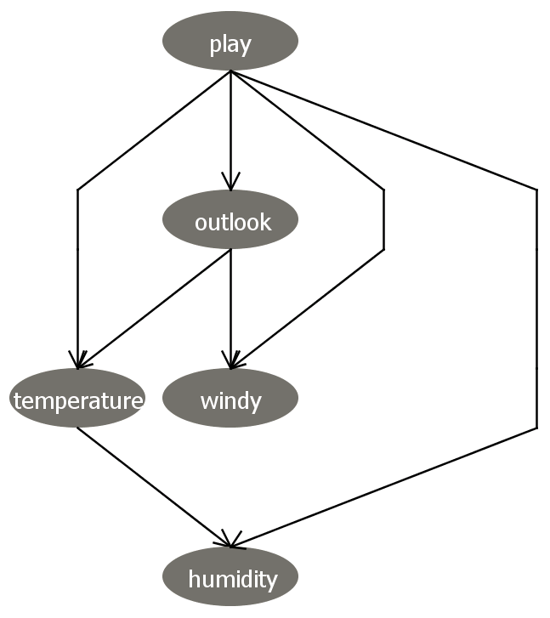

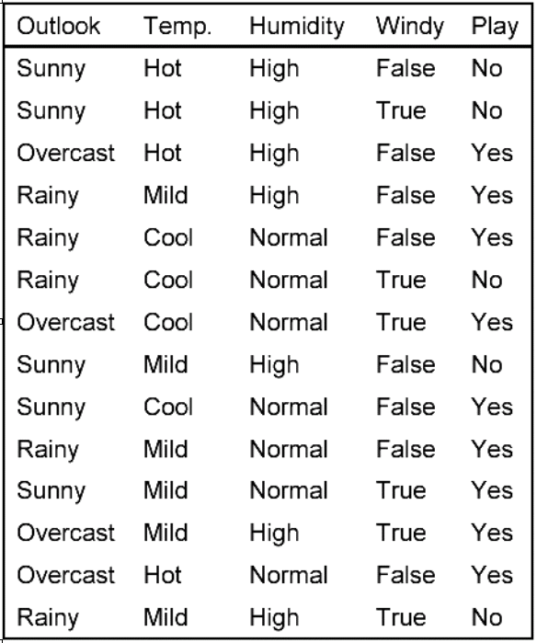
Play probability table
Based on the data…
P(play=yes) = 9/14
P(play=no) = 5/14
Let’s correct with Laplace …
P(play=yes) = (9+1)/(14+2) = .625
P(play=yes) = (5+1)/(14+2) = .375

Slide 21

Outlook probability table
Based on the data…
P(outlook=sunny|play=yes) = (2+1)/(9+3) = .25
P(outlook=overcast|play=yes) = (4+1)/(9+3) = .417
P(outlook=rainy|play=yes) = (3+1)/(9+3) = .333
P(outlook=sunny|play=no) = (3+1)/(5+3) = .5
P(outlook=overcast|play=no) = (0+1)/(5+3) = .125
P(outlook=rainy|play=no) = (2+1)/(5+3) = .375

Slide 22
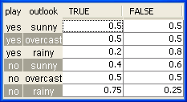
Windy probability table
Based on the data…let’s find the conditional probabilities for “windy”
P(windy=true|play=yes,outlook=sunny)
= (1+1)/(2+2) = .5

Slide 23
Windy probability table
Based on the data…
P(windy=true|play=yes,outlook=sunny) = (1+1)/(2+2) = .5
P(windy=true|play=yes,outlook=overcast) = 0.5
P(windy=true|play=yes,outlook=rainy) = 0.2
P(windy=true|play=no,outlook=sunny) = 0.4
P(windy=true|play=no,outlook=overcast) = 0.5
P(windy=true|play=no,outlook=rainy) = 0.75

Slide 24

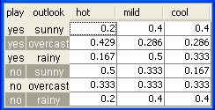

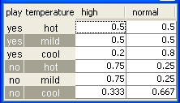
Final figure
Classify it
Classify it

Slide 25
Classification I
Classify it
P(play=yes|outlook=sunny, temp=cool,humidity=high, windy=true) =
α*P(play=yes)
*P(outlook=sunny|play=yes)
*P(temp=cool|play=yes,
outlook=sunny)
*P(humidity=high|play=yes,
temp=cool)
*P(windy=true|play=yes,
outlook=sunny)
= α*0.625*0.25*0.4*0.2*0.5
= α*0.00625

Slide 26
Classification II
Classify it
P(play=no|outlook=sunny, temp=cool,humidity=high, windy=true) =
α*P(play=no)
*P(outlook=sunny|play=no)
*P(temp=cool|play=no,
outlook=sunny)
*P(humidity=high|play= no,
temp=cool)
*P(windy=true|play=no,
outlook=sunny)
= α*0.375*0.5*0.167*0.333*0.4
= α*0.00417

Slide 27
Classification III
Classify it
P(play=yes|outlook=sunny, temp=cool,humidity=high, windy=true)
= α*0.00625
P(play=no|outlook=sunny, temp=cool,humidity=high, windy=true)
= α*.00417
α = 1/(0.00625+0.00417)
=95.969
P(play=yes|outlook=sunny, temp=cool,humidity=high, windy=true)
= 95.969*0.00625 = 0.60

Slide 28
Classification IV (missing values or hidden variables)
P(play=yes|temp=cool, humidity=high, windy=true)
= α*Σ_{outlook}P(play=yes)
*P(outlook|play=yes)
*P(temp=cool|play=yes,outlook)
*P(humidity=high|play=yes,
temp=cool)
*P(windy=true|play=yes,outlook)
=…(next slide)

Slide 29
Classification V (missing values or hidden variables)
P(play=yes|temp=cool, humidity=high, windy=true)
= α*Σ_{outlook}P(play=yes)*P(outlook|play=yes)*P(temp=cool|play=yes,outlook)
*P(humidity=high|play=yes,temp=cool)*P(windy=true|play=yes,outlook)
= α*[
P(play=yes)*P(outlook= sunny|play=yes)*P(temp=cool|play=yes,outlook=sunny)
*P(humidity=high|play=yes,temp=cool)*P(windy=true|play=yes,outlook=sunny)
+P(play=yes)*P(outlook= overcast|play=yes)*P(temp=cool|play=yes,outlook=overcast)
*P(humidity=high|play=yes,temp=cool)*P(windy=true|play=yes,outlook=overcast)
+P(play=yes)*P(outlook= rainy|play=yes)*P(temp=cool|play=yes,outlook=rainy)
*P(humidity=high|play=yes,temp=cool)*P(windy=true|play=yes,outlook=rainy)
]
= α*[
0.625*0.25*0.4*0.2*0.5 + 0.625*0.417*0.286*0.2*0.5 + 0.625*0.33*0.333*0.2*0.2 ]
=α*0.01645

Slide 30
Classification VI (missing values or hidden variables)
P(play=no|temp=cool, humidity=high, windy=true)
= α*Σ_{outlook}P(play=no)*P(outlook|play=no)*P(temp=cool|play=no,outlook)
*P(humidity=high|play=no,temp=cool)*P(windy=true|play=no,outlook)
= α*[
P(play=no)*P(outlook=sunny|play=no)*P(temp=cool|play=no,outlook=sunny)
*P(humidity=high|play=no,temp=cool)*P(windy=true|play=no,outlook=sunny)
+P(play=no)*P(outlook= overcast|play=no)*P(temp=cool|play=no,outlook=overcast)
*P(humidity=high|play=no,temp=cool)*P(windy=true|play=no,outlook=overcast)
+P(play=no)*P(outlook= rainy|play=no)*P(temp=cool|play=no,outlook=rainy)
*P(humidity=high|play=no,temp=cool)*P(windy=true|play=no,outlook=rainy)
]
= α*[
0.375*0.5*0.167*0.333*0.4 + 0.375*0.125*0.333*0.333*0.5 + 0.375*0.375*0.4*0.333*0.75 ]
=α*0.0208

Slide 31
Classification VII (missing values or hidden variables)
P(play=yes|temp=cool, humidity=high, windy=true) =α*0.01645
P(play=no|temp=cool, humidity=high, windy=true) =α*0.0208
α=1/(0.01645 + 0.0208)= 26.846
P(play=yes|temp=cool, humidity=high, windy=true) = 26.846 * 0.01645 = 0.44
P(play=no|temp=cool, humidity=high, windy=true) = 26.846 * 0.0208 = 0.56
I.e. P(play=yes|temp=cool, humidity=high, windy=true) is 44% and
P(play=no|temp=cool, humidity=high, windy=true) is 56%
So, we predict ‘play=no.’

